Slide 1


Understanding and Predicting Bank Customer Attrition
Brody Hill

Slide 2
The Problem:
In the current higher-for-longer rate environment, more customers than usual are withdrawing balances from the bank. It must be understood what customer attributes most influence attrition to develop targeted strategies to address them.

Slide 3
The Findings Thus Far:
A customers member status, their gender, and their geography are the most positive predictors of attrition.

Slide 4
The Data:
The dataset I used for this project contains data on 10,000 customers of a European Multinational Bank, with customers across Germany, France and Spain.
Notes:
Data contained within the dataset:
1. customer_id - unique key for each customer.
2. credit_score.
3. country.
4. gender.
5. age.
6. tenure - how long they've been with the bank.
7. balance - account balance.
8. products_number - number of the banks financial products each customer is enrolled in.
9. credit_card - indicates if the customer has a credit card or not.
10. active_member.
11. estimated_salary.
12. churn, used as the target - 1 if the client has left the bank during some period or 0 if he/she has not.

Slide 5
Data Wrangling:
Checked for duplicates and missing values (there weren’t any) and explored class distribution. 79.6% of customers had not churned, 20.4% had.
Ensured every columns data type made sense for the data it contained.
Renamed two columns to better describe what they contained.
Dropped the customer id column knowing it would not be useful for modeling.
Notes:
It’s not typical to have data that’s this clean. I’m well versed in the many strategies to handle and clean messy data. From imputing missing values with values that make sense given the context, to ensure each row contains unique data and redundant information is left out. If columns aren’t named in a way that makes them easy to work with, I’m well versed in strategies to handle that, typically misspellings, a mix of lower and uppercase, special characters, or unneeded white space.

Slide 6
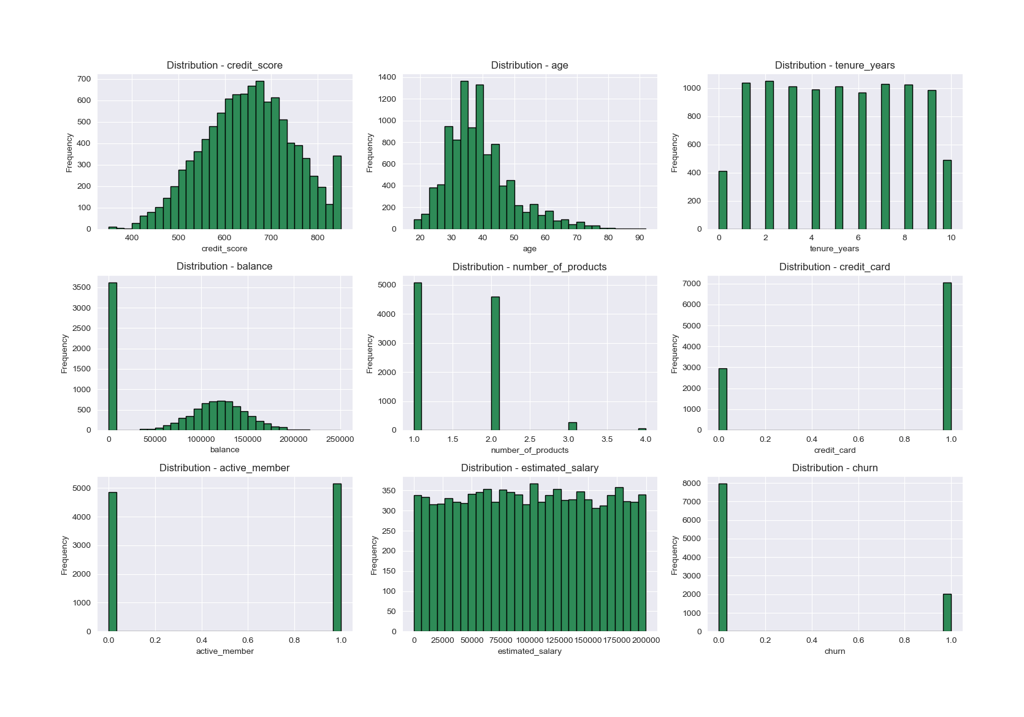
EDA Part 1:
Notes:
The 'balance' variable caught my eye first. We see a high imbalance in customers who don't have any money in the bank, but then a normal distribution for customers who do have money in the bank.
'age' and 'credit_score' look fairly normal. Age does have a slight left skew, and the credit score is a bit imbalanced towards the right, with more super-high credit customers than super-low credit customers.
The 'tenure' variable appears evenly distributed, and most customers have one or two products with the bank.
Our target variable, 'churn,' is imbalanced, but we already knew this.
Nothing alarming from these distributions, but it gave me ideas of where to explore first.
I decided to hone further in on age and credit score first given their skews.

Slide 7
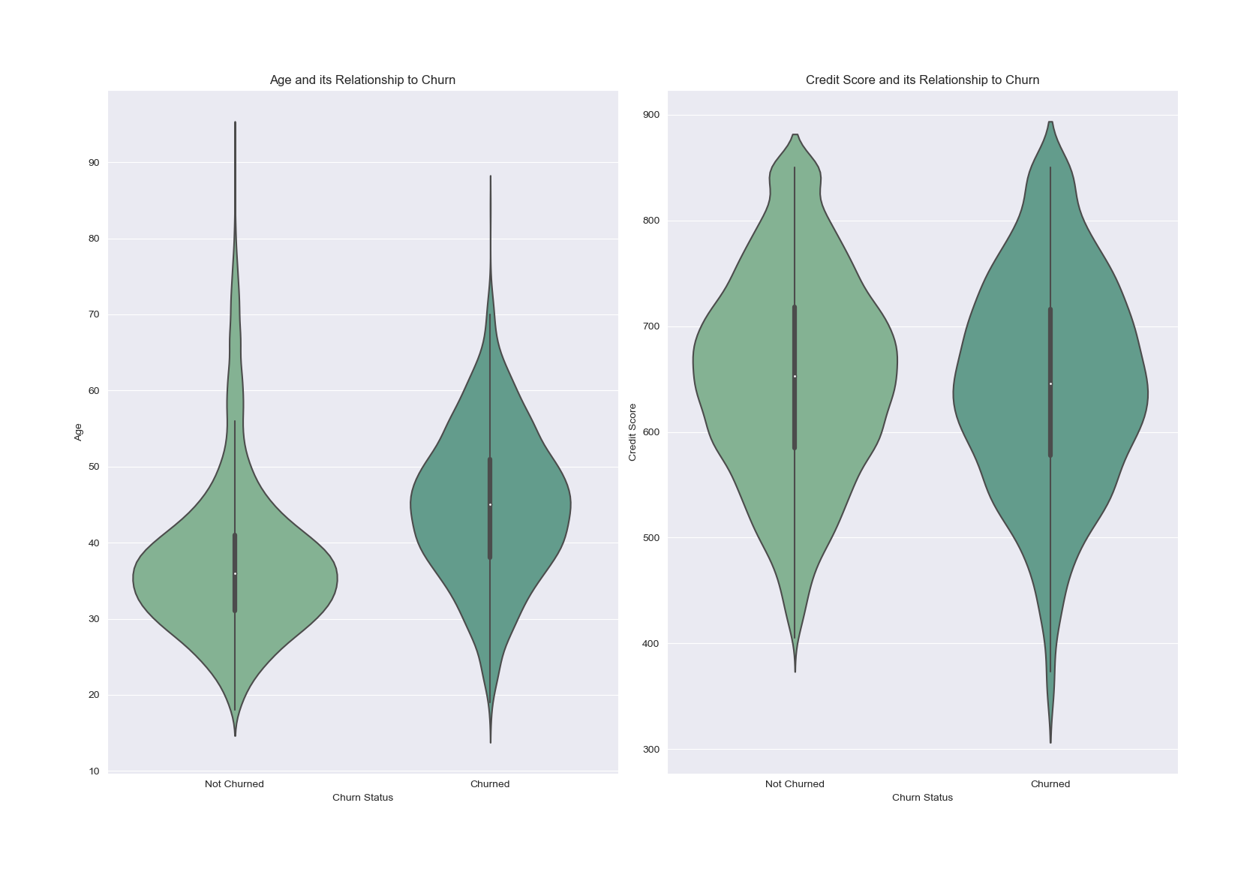
EDA Part 2:
Notes:
Customers who churn are a tad older than those who don't, but credit score didn't seem to tell me much. Density of the credit score data points appears close, as do the medians and quartiles. I would have thought credit score to be a better indicator of churn, but it didn't appear that way on initial inspection.
Next I ran some count plots to examine churn counts among various customer attributes.

Slide 8
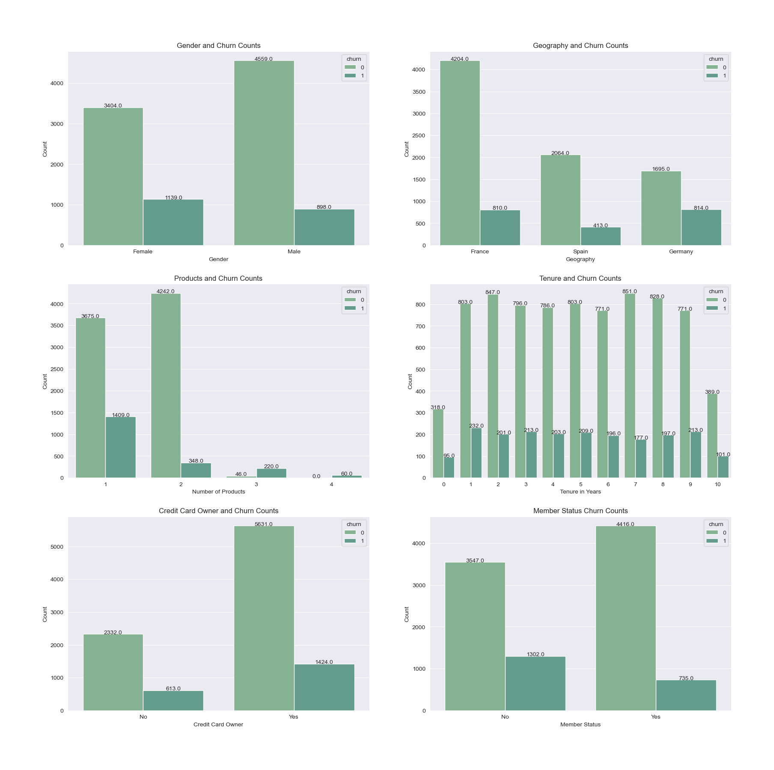
EDA Part 3:
Notes:
Churn imbalance appeared in favor of males, with a higher number of women churning in total and a greater proportion of women churning when compared to the total.
33.4% of female customers had churned, while only 19.6% of male customers had. A 70% increase.
It appeared Germany also had a higher churn imbalance than France and Spain. A greater proportion of customers in Germany had churned when compared to the total number of customers in the country. Germany also had the highest total number of churned customers at 814.
48% of all customers in Germany had churned, while only 20% had from Spain, and 19.2% had from France. What was happening in Germany to drive this massive imbalance?
More imbalances were observed between the number of products a customer had and churn status. There wasn't much data on customers with three and four products (although the imbalance on the data available was clear), and on products one and two, a larger imbalance of churn was observed across customers with one product compared to customers with two.
Tenure appeared fairly stable, with most customers churning after one year, but the balance remained stable at a high level.
The balance within owning a credit card and churn appeared close.
There was an imbalance between member status and churn. Customers who were not members churned 36.7% of the time, while customers who were members churned only 16.6% of the time.
At this point, a picture was starting to form. We could see females churned more often than males, German customers were churning at a higher rate, and member status seemed an important indicator. I felt comfortable moving on to modeling at this stage, but I needed to do some pre-processing first.

Slide 9
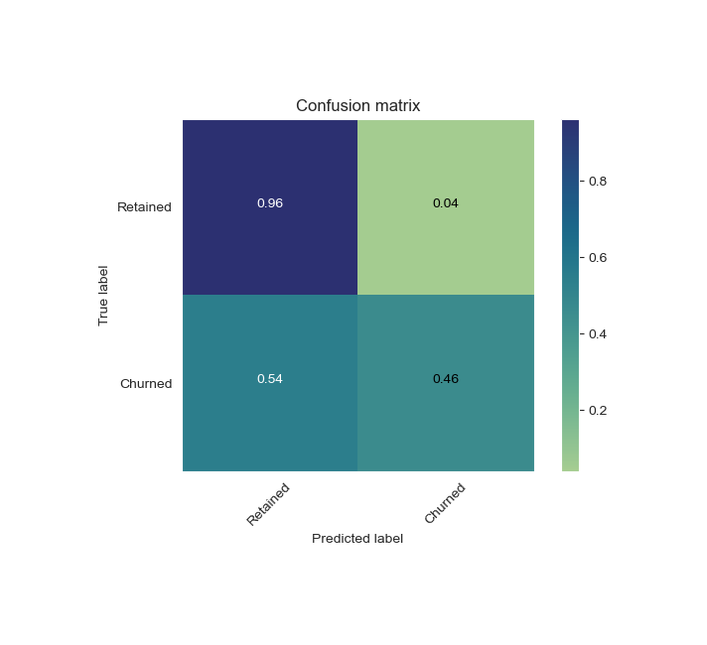


Modeling Part 1: Baselines
Notes:
Baseline model results from Random Forest, Gradient Boost, and XGBoost model. Chose to home in on XGB as it gave the best baseline results.

Slide 10
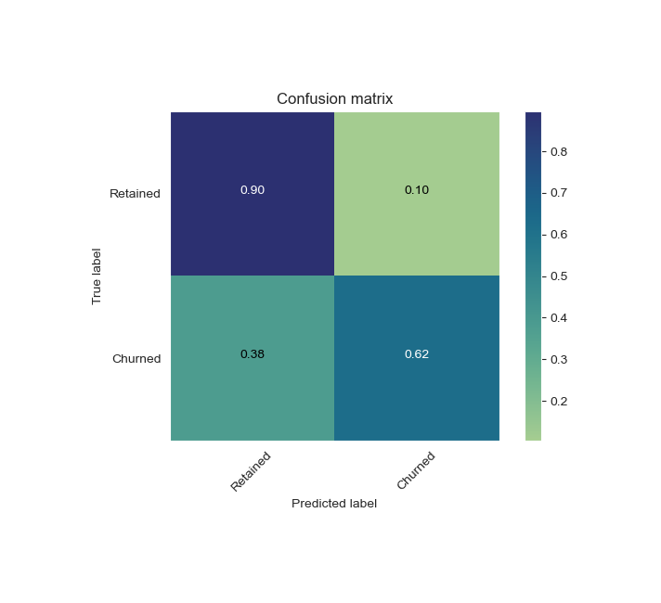
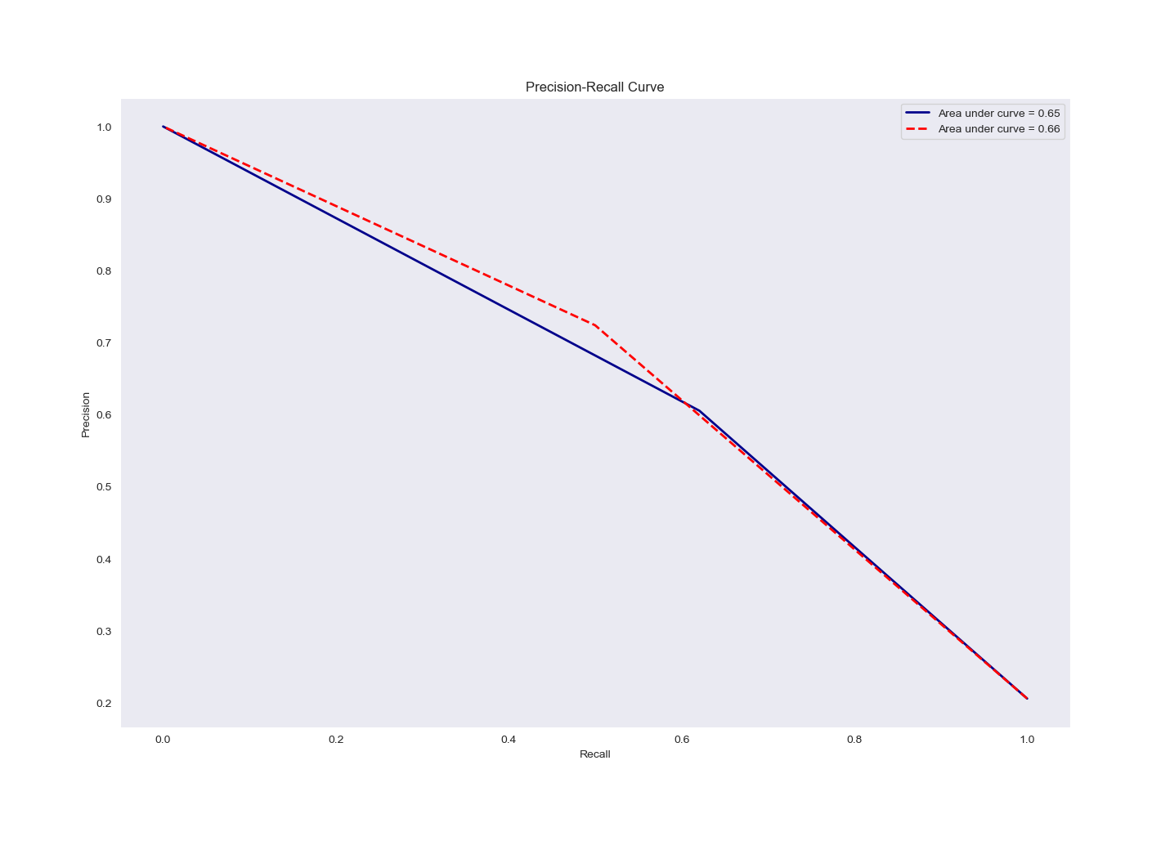
Modeling Part 2: Adjusting
Notes:
Results from over sampling the training data only. Class one recall improved 12%.

Slide 11
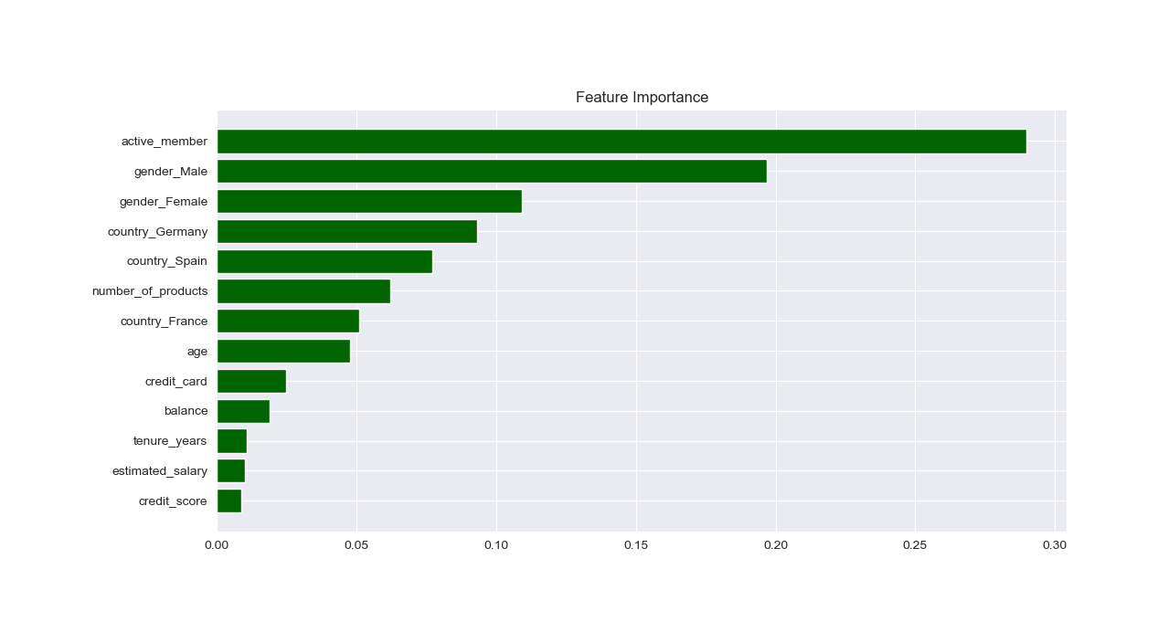
Modeling Part 2: Adjusting Continued
Notes:
Feature Importance from refined model, refined as a result of oversampling the training data. Next I dropped the male gender feature. It’s redundant information stemming from the encoding method used on the original gender feature. I suspect removing this redundant information will improve results.

Slide 12
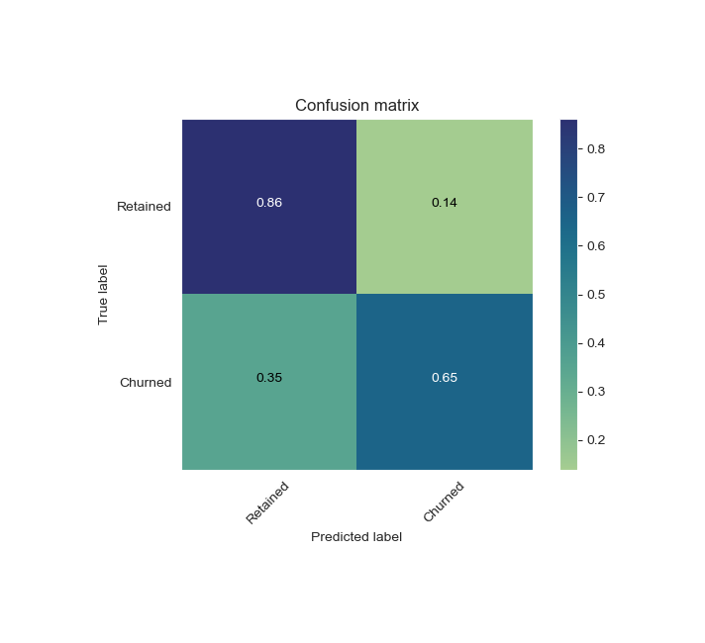
Modeling Part 3: Further Refined
Notes:
Improved result from dropping the gender_male feature and oversampling the only the training data. Class one recall increased another 3%. A 15% total increase in class one recall from oversampling the training data and dropping the male feature.

Slide 13
Modeling Part 3: The McNemar Test
McNemar Test Results:
P-value of 1.4249678757951758e-17. Extremely Small.
95% CI: (12.8% - 15.6%)
Notes:
What that's saying is, if the result really was due to random chance, the likelihood of observing a value at least as extreme as our 15% increase is only 0.000000000000000014249678757951758%. If these changes were to be made many times over, 95% of the time the increase in class one recall would be between 12.8% and 15.6%.
I then dropped the active member feature which decreased results, confirmed with a McNemar test.

Slide 14
Key Takeaways:
1. Active member status seems the best indicator of churn.
2. Gender and Geography play significant roles.
3. Further testing of each feature and their impact on model performance is needed.
Notes:
EDA showed more customers who were not active members churned, and removing that feature from modeling drove negative results. Given the two in combination, it appears the chance of losing a customer who is an active member is lower than the chance of losing a customer who is not an active member.
Customers with two products are least likely to leave the bank, with churn % greatly increasing past two products, though data there is limited.
Credit Score does not appear a significant factor in customer attrition, shown both in EDA results and model feature importance.
The average age of customers who have churned is higher than the average age of customers who have not churned, and it appears fairly significant from modeling as well.
Germany exhibits the highest churn rate, both as an absolute total and as a percentage compared to total customers.
Female customers are far more likely to churn than male customers.
Given the findings, a strategy moving forward may be to further investigate what's happening in Germany and what's happening with female customers to drive abnormal attrition rates among both.

Slide 15
Moving Forward:
1. Test each feature and it’s impact on model performance.
2. Gather more data on female customers , their member status and geography specifically to see if initial assumptions extend to a broader population.
3. Continue modeling with different methods to improve results.

Slide 16
Any Questions?

